Slide 1
Organizational Development in the Context of an International Civil Society Organization (ICSO)
Training of Heads of FOASPS Member Organizations in Association Management and Organizational Development (OD)
Module 10 :
Organizational culture in a non-profit Organisation
(Webinar 10)

Slide 2

Module 10 : Session Objective
By the end of the session, participants will have:
A definition of corporate culture and an understanding of its challenges
Clarification of key elements of corporate culture and the links between them
Mastery of knowledge management for sustainability

Slide 3

Session Structure and Outline
Chapter 10.1: Corporate Culture: Definition and Issues
Chapter 10.2: Key elements of the corporate culture (Company history, vision and mission, common values, operating methods, global communication)
Chapter 10.3: Knowledge Management for Sustainability

Slide 4

Chapter 10.1 :
Corporate Culture: Definition and Challenges(1/2)
  Corporate culture is also called organizational culture.
  It is a set of values, norms, beliefs, and behaviors that characterize a company.
  This is what gives an Organization its unique personality and determines how leaders and employees interact with each other and with customers.

Slide 5

Chapter 10.1:
Corporate Culture: Definition and Challenges (2/2)
This notion of organizational culture includes:
  The history of the company: it is by understanding this history that one can understand the values and practices of the company at a specific time
  The employer brand: which makes it possible to analyze the sense of belonging of all stakeholders, including employees
  HRM: which allows you to see how relationships between employees are managed, and their place in the maintenance or refocusing of the corporate culture.

Slide 6

Chapter 10.1 :
Some aspects of the corporate culture (1/3)
Performance culture: The Organization emphasizes efficiency. Employees are results-driven and are required to meet deadlines and targets.
Culture of collaboration: The Organization values teamwork and fosters collaboration at all levels. Employees work together to achieve common goals and there is a strong culture of communication and cooperation.

Slide 7

Chapter 1101 :
Some aspects of the corporate culture (2/3)
Culture of innovation: The Organization values creativity. Employees are encouraged to think innovatively and come up with innovative ideas to improve processes and outcomes
Workplace Safety Culture: The Organization trains its employees to take into account risks, and to work in complete safety with the aim of avoiding accidents and human and material damage

Slide 8
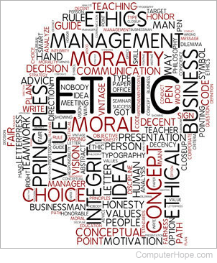
Chapter 10.1:
Some aspects of the corporate culture (3/3)
Culture of Shared Results: The Organization gives great importance to the well-being of staff and associates them with achievements, successes and good organizational performance as well as failures and underperformances
Culture of ethics: The Organization values moral principles and standards of respect for recognized rights. Employees are trained to adhere to the ethical standards and rules of conduct set by the company.

Slide 9
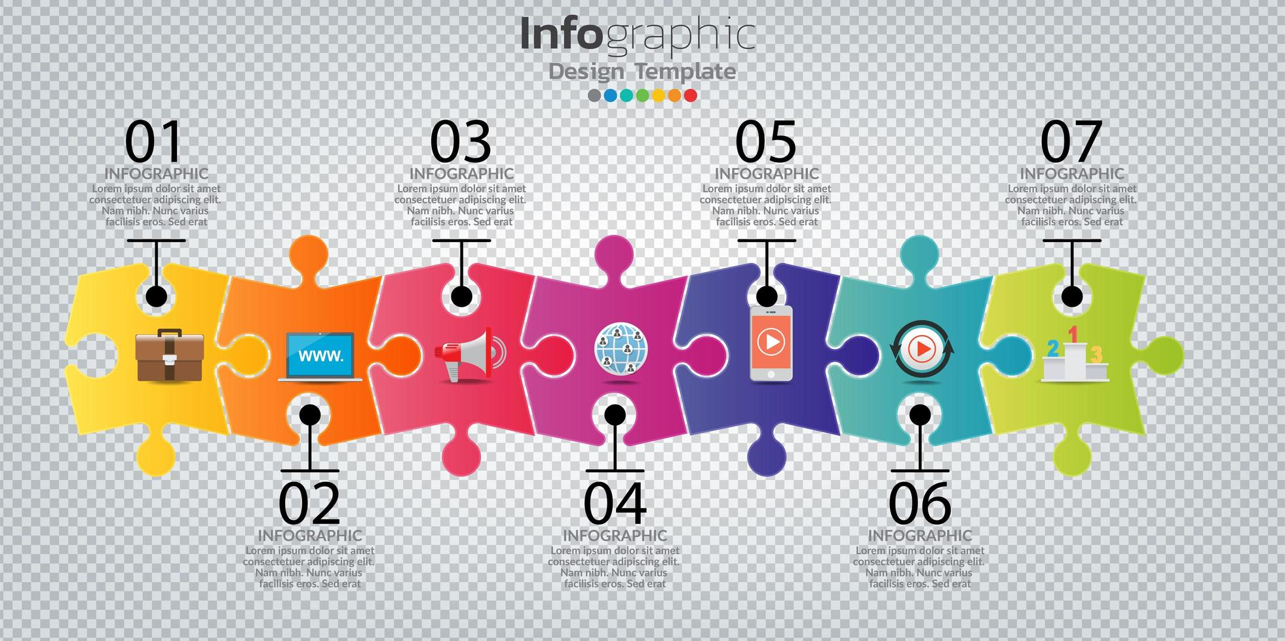
Chapter 10.2 :
Key elements of corporate culture (1/5)
  Company History
  When was the association created, by whom and how?
  What was the context that motivated the founders' decision to create this association?
  What support did they receive during the creation and after?
  From all this historical information, what can we retain in terms of the specificity of our association

Slide 10

Chapter 10.2 :
Key elements of corporate culture (2/5)
  Vision and Mission
  Are the vision and mission of the association clearly defined in the legal texts?
  Do this vision and missions indicate an orientation (humanitarian, social, inclusive, strategic for the country or community, etc.)?
  How can these elements impact the corporate culture of our association?

Slide 11

Chapter 10.2 :
Key elements of corporate culture (3/5)
  Shared values
  Where do we find the values of the association?
  In a charter of ethics
  In the association's guiding principles
  How do we do it when there is no document that does not provide a framework for common values?
    In an appropriate exercise to identify the values common to the vast majority
    Drafting of the document by a dedicated committee
    A broad consultation for final validation

Slide 12

Chapter 10.2 :
Key elements of the corporate culture (4/5)
  Modes of action
  This is a strategic aspect of the way the association intervenes.
  We can proceed by
    Direct interventions (execution with the association's agents)
    Intervention by "subcontracting" to implementing partners
    The partnership and networking approach
  Does the association opt for IGA (Income Generating Activities) or only relies on subsidies?

Slide 13

Chapter 10.2 :
Key elements of corporate culture (5/5)
  Global Communication
  This is an aspect that must be given great importance, through:
  An internal communication strategy:
    Manage how information circulates within the association with a view to the involvement of all
  An external communication strategy:
    Manages the means and tools for sharing information with targets outside the association
  A global communication strategy:
    Ensures consistency between the two strategies

Slide 14

Chapter 10.3 :
Knowledge Management for Sustainability (1/6)
Knowledge management is a guarantee of the sustainability of organizations
It is defined as the process of seeking, organizing, curating, and disseminating information so that a specific group of people can access and work with that information
A standardized knowledge management process helps an association to organize its activities well in the long term and to remain efficient.

Slide 15

Chapter 10.3 :
Knowledge Management for Sustainability (2/6)
Three types of knowledge to consider:
Tacit knowledge:
  This knowledge is usually acquired through experience, and is understood intuitively.
  It is difficult to articulate and codify them, and therefore to transmit them to other people.
  Examples include language, facial recognition ability, leadership skills, and the ability to take initiative.

Slide 16

Chapitre 10.3 :
Gestion des connaissances pour la pérennisation (3/6)
Three types of knowledge to consider:
Implicit knowledge:
  While some experts equate implicit knowledge with tacit knowledge, others differentiate between them, arguing that the definition of tacit knowledge is more nuanced than one might think.
  While tacit knowledge is difficult to codify, implicit knowledge does not necessarily pose the same problem.
  Implicit information should be documented.
  They tend to exist within processes, and can be described as knowledge of "know-how".

Slide 17
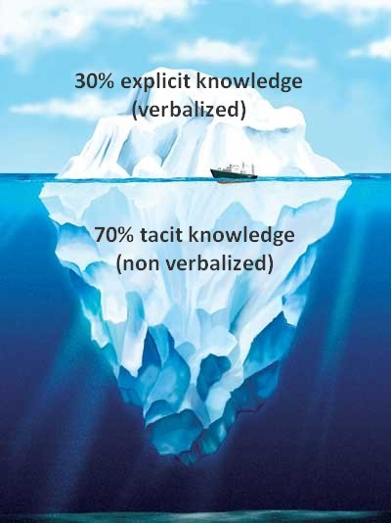
Chapitre 10.3 :
Gestion des connaissances pour la pérennisation (4/6)
Three types of knowledge to consider:
Explicit knowledge:
  Explicit knowledge is recorded in various types of documents such as manuals, reports, and guides,
  This type of knowledge is probably the best known.
  Databases, white papers, and case studies are examples of this.
  This form of knowledge is important for retaining intellectual capital within an organization and for facilitating the transfer of knowledge to new employees.

Slide 18

Chapter 10.3 :
Knowledge Management for Sustainability (5/6)
Knowledge Management Insights
Computer science
  Ways of accessing the different platforms/work tools available to staff
  When and how to send a request for support from the IT department/service?
  Rules and procedures for downloading new software
Human resources
  Guide for new staff and the employee in general
  How do I access payslips and other reporting tools?
  How do I submit a travel/leave request?

Slide 19

Chapter 10.3 :
Knowledge Management for Sustainability (6/6)
Knowledge Management Insights
Communication and marketing
  Guidelines for the use of the brand charter and the different forms of the brand
  Best practices to adopt on social networks
  External communication and press relations management systems
Sales
  Competitive and partner information
  Promotional and sales materials (e.g. brochures and brochures)
  Information about commissions and proposal response templates

Slide 20

Chapter 10.3 :
Knowledge Management Process (1/5)
Gather information
  Gather as much useful information as possible.
  This is the most difficult part
  Ask current team members about their roles and responsibilities.
  Glimpse the structure of the current team with its development prospects
  Identify and assemble all existing documentation and put it into shareable formats
  For an older / bigger organization, you can use the service of an external consultant
  Decide whether to prioritize the information to be included in the knowledge management model

Slide 21

Chapter 10.3 :
Knowledge Management Process (2/5)
Organize and store the data collected
  This is the core of the team's work.
  Determine which knowledge base to use, but also how to store the information and organize it by asking yourself a few questions:
    How do you want your employees to access the information you store?
    How often will they consult this information?
    What information do you want to keep?
  Adopt a knowledge management tool, allowing you to list all the documents you need, so that everyone can refer to them if necessary

Slide 22

Chapter 10.3 :
Knowledge Management Process (3/5)
Disseminating information
  You need to make stored information accessible to everyone who needs it.
  Train your team and communicate regularly with everyone to determine when and how to use the knowledge management platform.
  Don't let your colleagues know out of the blue. You risk causing confusion or malfunctions in existing processes.
  Develop a change management process and adopt best practices to ensure that your new knowledge base is right for your team, and that it can be integrated into that same process in the future.

Slide 23

Chapter 10.3 :
Knowledge Management Process (4/5)
Harnessing knowledge
  The knowledge base and knowledge management process are in place,
  Your team should now be able to access the knowledge base whenever needed.
  Make sure that your team regularly updates the data in this database to ensure maximum accuracy.
  Appoint a manager in each team who is responsible for checking and updating information on a quarterly basis.
  Once teams are accustomed to the knowledge management process, updating the knowledge database can be regularly integrated into the process

Slide 24

Chapter 10.3 :
Processus de gestion des connaissances (5/5)
Some common mistakes in knowledge management
  Thinking that you can do Knowledge Management (KM) effortlessly
  Knowledge management is a reliable process, but without regular updates,
  Information not shared by some team members
  Incorrect or outdated information in the knowledge base
  Knowledge base too complex

Slide 25

CONCLUSION
  Corporate culture or organizational culture is a complex topic that can be difficult to cover in a single session
  What must be remembered, however, is that this subject is important and deserves special attention
  We can only recommend to leaders, team leaders, to find from time to time opportunities to put this subject on the agenda of certain meetings of their departments
  This will then be an opportunity to see if there is harmony, coherence and shared opinions within the teams, and to decide on the course of action to be taken

