Slide 1
Organizational Development in the context of International Civil Society Organization (CSO)
Training in Association Management and Organisational Development (OD) for Heads of Member Organisations
Module 1 :
Administrative Management of Associations
(Webinar 1)

Slide 2

Module 1 : Session’s Objectives
By the end of the workshop, participants will have explored:
The processes of creating an association and the tools for acquiring its legal statutes
Management of the membership of an association through service to members as a means of maintenance and development
The roles and prerogatives of the employees of the association in their relations with other bodies

Slide 3

Session’s structure & Plan
Chapter 1.1: Creation of the association and acquisition of legal personality
Chapter 1.2: Workforce Management: Maintenance and Development, Member Service
Chapter 1.3: The roles and prerogatives of employees of the association

Slide 4

Chapter 1.1 (1/8):
Process for creating an association
An association is born of the desire of a group of people to create a space to sharing a vision and action to achieve a goal
A gestation period may be necessary to broaden the interest group to ensure a broad adherence to the legal documents
The legal texts are the statutes and the Rules of Procedure
The General Constituent Assembly (GCA) establishes the birth of the association and the election of the first Executive Board (EB)
The GCA mandates the EB to complete administrative procedures (Declaration and Registration paper)
Opening a bank account requires a minute of the General Constituent Assembly

Slide 5

Chapter 1.1 (2/8):
Process for creating an association
ASSOCIATION CONSTITUTION’S STRUCTURE
PREAMBLE
TITLE I : DENOMINATION – HEADQUARTERS – DURATION
Article 1 : Denomination
Article 2 : Headquarters.
Article 3 : Duration.
TITLE II : AIM – OBJECTIVES – AREAS OF INVENTION – MEANS OF ACTION
Article 4 : Aim
Article 5 : Objectives
Article 6 : Areas of intervention
Article 7 : Means of actions

Slide 6
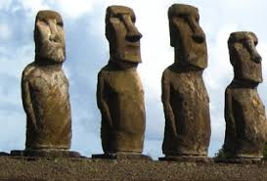
Chapter 1.1 (3/8):
Process for creating an association
ASSOCIATION CONSTITUTION’S STRUCTURE
TITLE III: MEMBERS – METHOD OF MEMBERSHIP – MEMBERSHIP
Article 8: Members
Article 9: Founding Members,
Article 10: Active members,
Article 11: Sympathizing members,
Article 12: Honorary Members
Article 13: Membership
Article 14: Loss of membership
Article 15: Means of resignation
Article 16: Exclusion of members
Article 17: Rights and duties of members who resign

Slide 7

Chapter 1.1 (4/8):
Process for creating an association
ASSOCIATION CONSTITUTION’S STRUCTURE
TITLE IV: ORGANISATION – FUNCTIONING
Article 18: The organs of the association
Article 19: Definition and powers of the General Assembly
Article 20: Functioning of the General Assembly
Article 21: Composition of the Board of Directors
Article 22: Prerogatives of the Board of Directors
Article 23: Meetings of the Board of Directors
Article 24: Non-remuneration of members of the Board of Directors
Article 25: Responsibilities of the President
Article 26: Responsibilities of the Secretary General
Article 27: Responsibilities of the General Treasurer
Article 28: Responsibilities of Advisors
Article 29: Responsibilities of the Executive Directorate
Article 30: Description of the functions of the Executive Director
Article 31: Election and term of office of statutory auditors

Slide 8

Chapitre 1.1 (5/8):
Process for creating an association
ASSOCIATION CONSTITUTION’S STRUCTURE
TITLE V: FINANCIAL PROVISIONS
Article 32: Resources of the association
Article 33: Opening of the association's accounts and operating model
Article 34: Deposit obligations and small cash arrangements
Article 35: Resources made available to the association by the partners
TITLE VI: FINAL PROVISIONS
Article 36: Conditions for amending the articles of association
Article 37: Conditions for the dissolution of the association
Article 38: Limitation of the association's commitments to its assets only
Article 39: Adoption of rules of procedure
Article 40: Jurisdiction to hear disputes
Article 41: Effective date of the articles

Slide 9

Chapter 1.1 (6/8):
Process for creating an association
STRUCTURE OF THE ASSOCIATION'S INTERNAL REGULATIONS
PREAMBLE
Article 1: Acronym and Logo
Article 2: Fiscal Year
Article 3: Admission of new members
Article 4: Resources of the Private Health Sector Platform
Article 5: Functioning of the General Assembly
Article 6: Convening of an extraordinary General Meeting
Article 7: Status and prerogatives of the persons sitting on the General Assembly
Article 8: Election of the Executive Board
Article 9: Functioning of the Executive Board
Article 9: Functioning of the Council
Article 11: Rules for the delegation of responsibility
Article 12: Replacement of a member of the Executive Board
Article 13: Constitution of Standing Committees
Article 14: Functioning of the Standing Committees

Slide 10

Chapter 1.1 (7/8):
Process for creating an association
STRUCTURE OF THE ASSOCIATION'S INTERNAL REGULATIONS
Article 15: Bureau of the Standing Committees
Article 16: Resources of the Standing Committees
Article 17: Functioning of the Technical Advisory Committees:
Article 18: Powers, functioning and resources of the Administrative Secretariat
Article 19: Recruitment of the Administrative Secretary
Article 20: Performance agreement of the Administrative Secretary
Article 21: Attributions, functioning and resources of the regional antenna
Article 22: Rules of solidarity within the Platform
Article 23: Loss of membership
Article 24: Suspension, reprimand and disbarment
Article 25: Resignation of a member
Article 26: Exclusion
Article 27: Dispute and Disputes Resolution
Article 28: Modification and amendment
Article 29: Transitional Provisions

Slide 11

Chapter 1.1 (8/8):
Process for creating an association
DIFFERENCE BETWEEN THE STATUTES AND THE RULES OF PROCEDURE
The articles of association are filed with the administration and should therefore contain general provisions that are not likely to change every three years
Any changes to the articles of association must be brought to the attention of the administration, which a priori verifies their constitutionality
The internal regulations are not subject to the administration and can be modified if necessary without suffering from some administrative constraints
The internal regulations must not take up the articles of the statutes, but operationalize them by developing the conditions for implementation
The templates provided in the participants' manual (model proposed by the Ministry of the Interior of Togo) give more details on what should be included in the statutes and internal regulations

Slide 12

Chapter 1.2: Membership Management (1/7)
Objective of this component:
To allow participants to equip themselves for:
Growing and retaining their membership
Strengthen members’ buy in to the association's services

Slide 13

Chapter 2.2 : Membership Management (2/7)
Let's talk little, but let's talk well?
What are the articles of your constitutions and internal regulations that give indications on conviviality between members?
What are the activities you carry out in the direction of developing good relations between members?
What can we do differently to retain our organization’s members and establish a real conviviality?

Slide 14
Chapter 1.2: Membership Management (3/7):
MEMBER MOTIVATION MODEL
1
1- This involves unifying activities and projects, which create enthusiasm
6- Don't settle for the little, but set the bar high enough. And aim for optimal performance
Creating a new vision
6
2
2- By doing what you want others to do in the association and in the teams
Striving for perfection
Leading by example
CONFIDENCE
& MUTUAL
RESPECT
5- It is a question of identifying symbols to create events that celebrate the successes of
The association
5
3
3- In an association, it is necessary to ensure that every member is part of a project team (or is active)
Celebrating Successes
Empowering its members
4
4- It is about defending and promoting members and bringing them to the forefront
Defending their cause

Slide 15
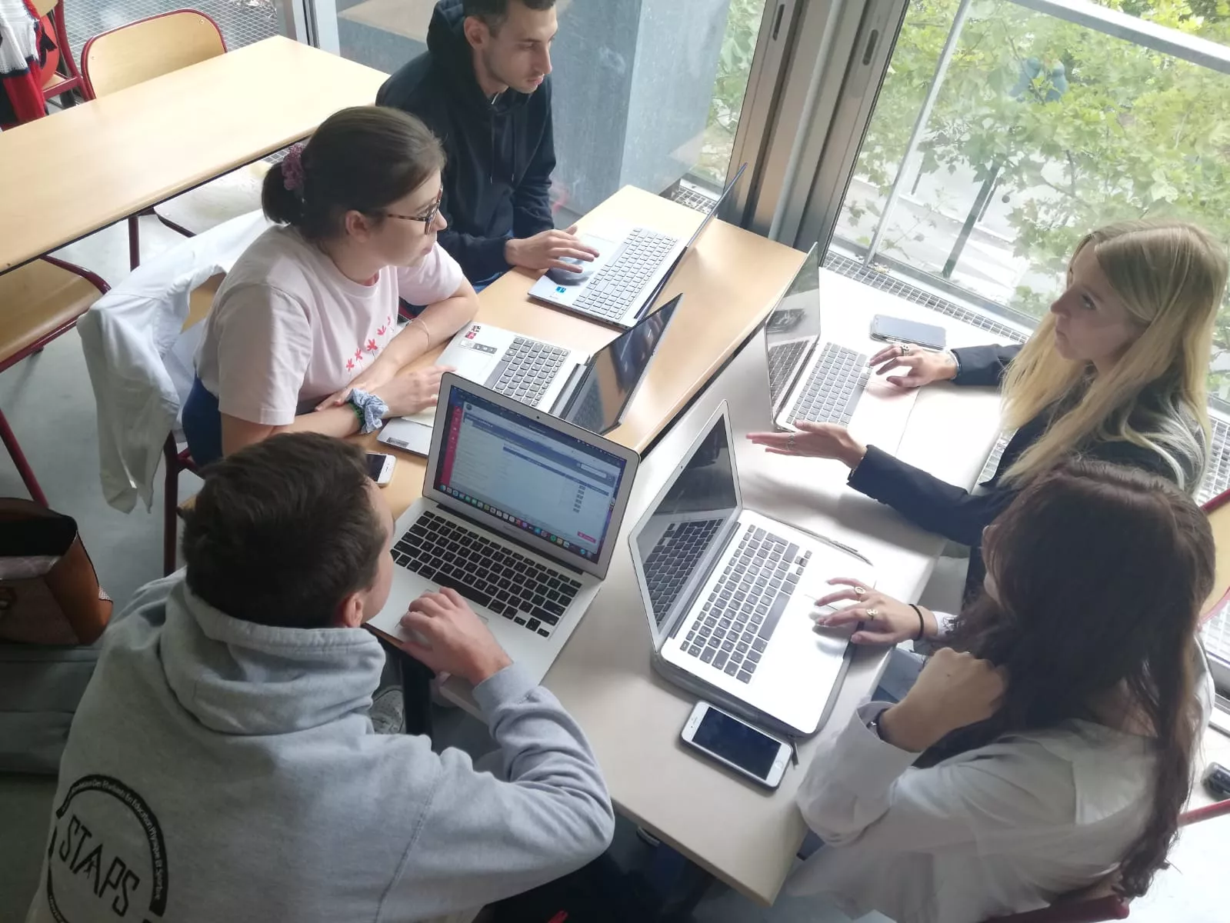
Chapter 1.2: Membership Management (4/7)
MEMBER SERVICES TO CREATE MAINTENANCE AND EXTENSION
Let’s think of this one minute:
Question 1: Why don't members pay their dues?
Question 2: How do you know what members expect from the association?
Question 3: How do you reassure members that their money is well managed for the best of the association?

Slide 16
Chapter 1.2: Membership Management (5/7)
The interest of these three questions is to show that:
Members do not pay their dues, because, among other things, they do not know what their money is used for
So one way to strengthen spontaneity in the payment of dues is transparency in the management of the association's resources
But to be in tune with your members, you have to give them the floor to tell you what they expect from their association and its leaders (direct meetings, focus groups or opinion polls)

Slide 17

Chapter 1.2: Membership Management (6/7):
Membership Development Survey (1/2)
Questions to ask in a squad development survey?
What are the benefits of being a member of our association?
What do you think you will benefit from joining our association (potential members)?
What are your expectations of our association?
How do you see the association in relation to the public sector?
How do you see our association in relation to the technical and financial partners (TFPs)?
How do you see our association in relation to the general public?
What challenges do you face as a member of our association?
Do you have any recommendations for our association to become more relevant and useful to its members?

Slide 18

Chapter 1.2: Membership Management (7/7):
Membership Development Survey (2/2)
Questions to ask in a squad development survey?
Do you have any recommendations to help our members get more out of their membership?
What level of membership fees do you think is the right fee to be paid by our members?
What services do you think our association should offer to support its members?
What kind of member services can our association offer its members?
What are your specific needs that you haven't yet found an answer to?
What are your most important training needs?
Do you have any other comments/recommendations?

Slide 19
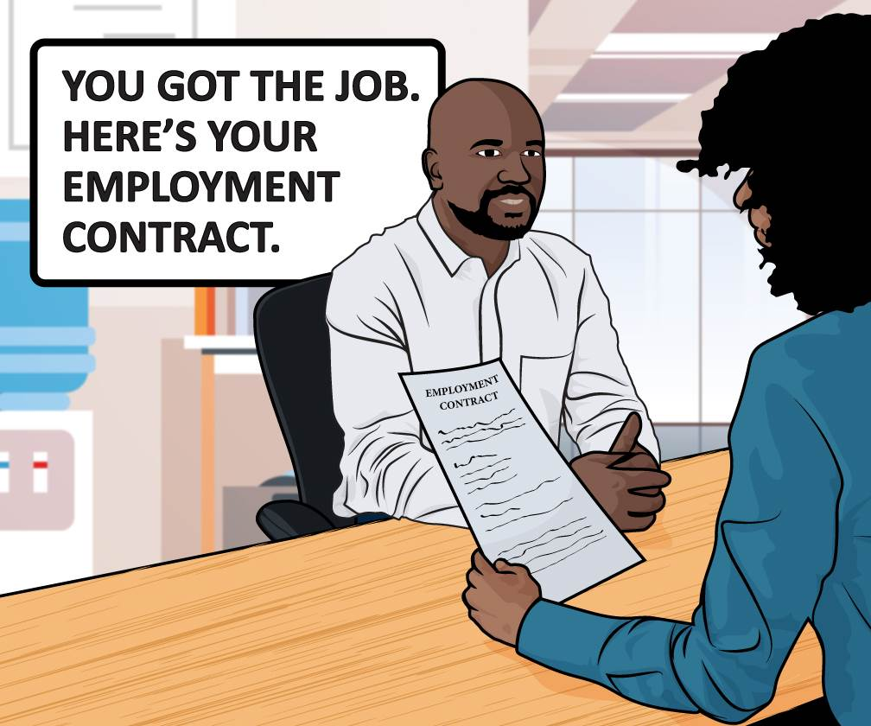
Chapter 1.3:
Roles of the association’s paid staff
The salaried staff is responsible for the day-to-day management of the association
It is headed by an Executive Director, a Permanent Secretary or an Administrative Secretary, etc.
He/She is on both fronts of project management and assistance to the BE/Board
It implements the decisions of the General Assembly on the instructions of the Executive Board or the Board of Directors and its President
He or she assumes administrative responsibilities relating to the life and functioning of the association
He/she implements the plan for mobilizing the human, material and financial resources necessary to achieve the objectives of the association;
It is structured in a coordination of the skills available to manage the projects entrusted to it through the directorates/departments and the technical services.

Slide 20

Chapter 1.3:
Characteristics of the association’s paid staff
Characteristics of the members of the association’s paid staff
Availability and sense of service and sacrifice
Humility towards the association's leaders
Sense of initiative and ability to share his address book with the association
Ability to work to highlight the talents of the President and members of the Executive Board
Easy communication and marketing ability of the association's vision
Writing skills
Project management skills

Slide 21
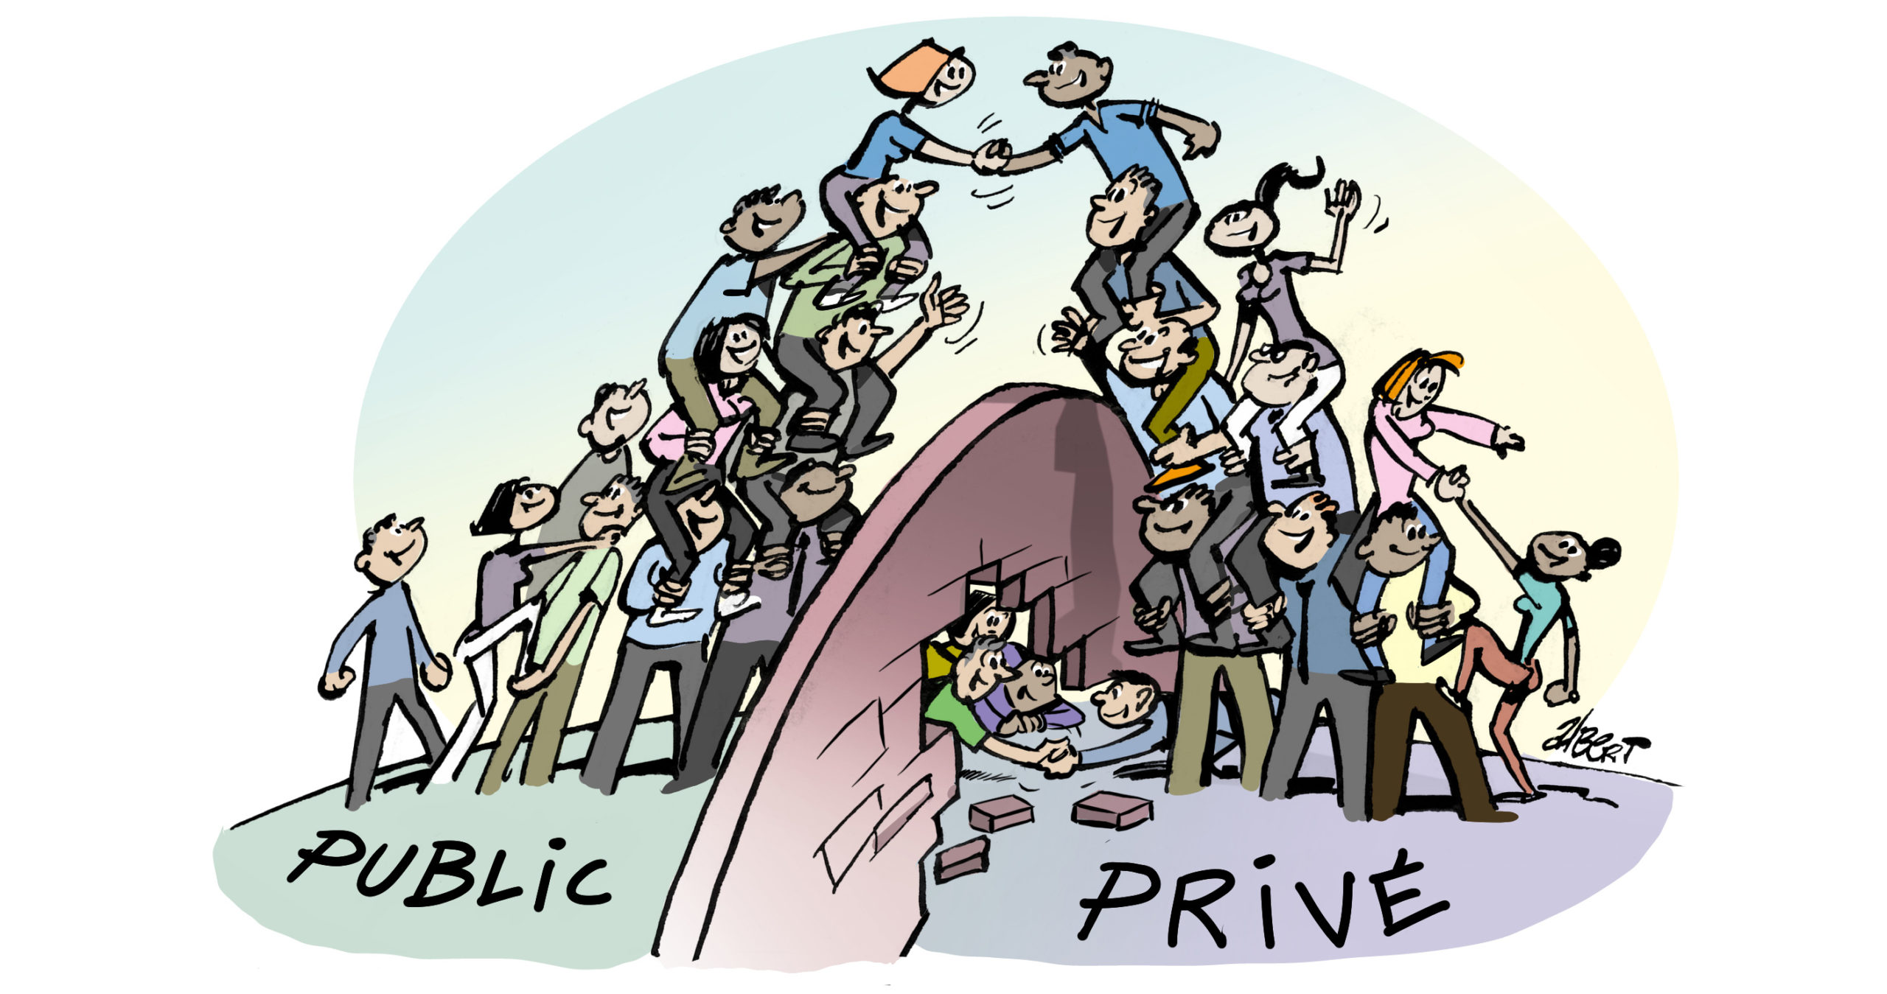
CONCLUSION
The three main challenges of the administrative management of the association are:
The legal texts (statutes and internal regulations) at the time of creation
Administrative texts during the management of the association's operation (procedures manuals and other management guide)
Administrative tools to lubricate the administrative and financial procedures
If one of the steps has been missed or badly negotiated, you must have the courage to reformat the association by modifying the texts
Be creative and available to support the EB and the GA

