Slide 1
Organizational Development in the Context of an International Civil Society Organization (ICSO)
Training of Heads of FOASPS Member Organizations in Association Management and Organizational Development (OD)
Module 2:
Governance of the association (Webinar 2)

Slide 2

Module 2: Session Objective
By the end of the workshop, participants will have a better understanding of:
The bodies required for the proper management of the association and their respective powers
The Governing Bodies of the association and their role of orientation and control
The Charter of Ethics and its place in the credibility of the association

Slide 3

Session Structure and Outline
Chapter 2.1: The organs of the association and their powers
Chapter 2.2: The Governance Bodies of the Association
Chapter 2.3: The association's charter of ethics and credibility

Slide 4

Chapter 2.1 (1/9):
The organs of the association and their powers
Reminder: the creation and operation of associations do not follow the same rules in the French-speaking culture (of Latin law) and the English-speaking culture (of the Common Law)
Francophones: Association Loi 1901 managed by the Ministry in charge of the administration of the territory
English speakers: Non for profit Organization managed by the General Registration Department (Registrar General)
The boards of directors were not the approach of the associations under the 1901 law, but today we see this
Among Anglophones, a body like the Board of Trustees does not exist among Francophones, and it is confusing with the Board of Directors

Slide 5
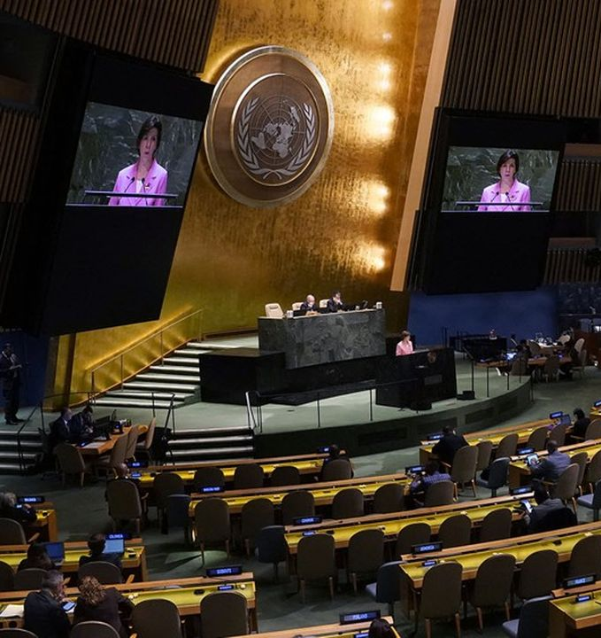
Chapter 2.1 (2/9):
The organs of the association and their powers
The General Assembly
Main decision-making body
Regular and special meetings
Has exclusive prerogatives
  Election of members of the other bodies (Board of Directors, EB, Admin Secretary. Auditors)
  Management of real estate assets in particular
  Ratification of partnerships and admission of other organizations
  Amendment of the articles of association and the IR, and dissolution
  Mandates the Board of Directors or the Executive Bureau who reports to him and manages the Association between two General Assemblies

Slide 6
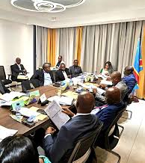
Chapter 2.1 (3/9):
The organs of the association and their powers
The Board of Directors
Implementing body of the association's vision
Implements the decisions of the General Assembly and replaces it between two meetings and reports to it
Recruits staff and monitors their work
Processes affiliation requests (in & out)
Negotiates partnerships with organizations that share a similar vision and goals, signs them and submits them for ratification by the GA
Initiates advocacy and resource mobilization actions

Slide 7

Chapter 2.1 (4/9):
The organs of the association and their powers
The Executive Board (EB)
  In some statutes, we do not have the BE and the CA, but one of the two. Thus, in the absence of a Board of Directors, the BE plays the same roles
  If both bodies exist,
  So the Board elects a reduced number of members to make up the BE.
  Sometimes the Board of Directors can also be a BE extended to other managers of affiliated structures
  The Board then becomes a body whose powers are below the General Assembly but above the BE...
  Having both bodies can be justified by the nature of the association (Example: FOASPS and Country Federations)

Slide 8

Chapter 2.1 (5/9) :
The organs of the association and their powers
The technical commissions
When the functioning of the association requires permanent reflection to feed the choices of the EB or the BD, permanent technical commissions may have been created by the Statutes
They can be thematic or functional (Examples, etc.)
They work under the responsibility of the BE/CA with the means made available to them by the association's budget
They report to the EB/ Board of Directors who implement these recommendations or bring them to the decision of the General Assembly
They are good ways to keep members involved in the association's activities

Slide 9

Chapter 2.1 (6/9) :
The organs of the association and their powers
Ad hoc committees
They become necessary in relation to specific needs
They are then created by decision of the General Assembly or the BE/CA
They have ToR or mission letters from the EB/ CA
They may call on external expertise depending on their mission
They disappear at the end of their mission and after submitting their reports

Slide 10

Chapter 2.1 (7/9) :
The organs of the association and their powers
Regional branches
They are provided for in the constitution according to the nature of the association
This is undoubtedly the case for the country federations of FOASPS
Their operation must be guided by the constitution and/or the IR for the purpose of harmonizing procedures from one region to another
This is a case where the EB extended to the presidents of the regional branches can constitute a Board of Directors

Slide 11

Chapter 2.1 (8/9) :
The organs of the association and their powers
The administrative secretariat
It is the body that brings together the paid staff
It is the armed wing of the GA and the EB
It is the support team for the EB but also the basic Project Management Unit (PMU) of any project carried out by the association
It may not be included in the articles of association as a formal body. In this case, its existence and operation must be sealed in a decision of the Executive Board

Slide 12

Chapter 2.1 (9/9) :
The organs of the association and their powers
The auditor (Internal/external)
The size of the association can make it possible to have an internal auditor. But it is an external audit professional who is normally recruited for this mission
Sometimes referred to as an auditor
Is responsible for controlling the management of the association's resources in accordance with international norms and standards
His report is submitted to the General Assembly, which mandates him and renews his mandate
Some articles of association limit the number of terms of office of the auditor

Slide 13

Chapter 2.2 (1/5) :
The Governance Bodies of the Association
Definition :
All the organizational mechanisms aimed at regulating the powers of managers and influencing their decision-making processes.
The governance of an association makes it possible to define the cases of discretionary powers and the cases of obligation to have recourse to another body.
In general, the question of governance concerns the EB and especially the President

Slide 14

Chapter 2.2 (2/5) :
The Governance Bodies of the Association
Relations with the General Assembly:
The General Assembly takes precedence over all organs, even the President
The president only has the possibility to refuse to comply and not to change the decisions of the General Assembly
The General Assembly has the exclusive prerogative to give a discharge to the EB
The Administrative Secretary is responsible for helping the two bodies to function in harmony and mutual respect

Slide 15

Chapter 2.2 (3/5) :
The Governance Bodies of the Association
Within the Executive Board / Board of Directors:
The President has the last word
But the president must seek consensus with the other members
He must never appear before the General Assembly with files shunned by his colleagues
In return, the members of the BE/CA are bound by the duty of discretion and cohesion in action
The Administrative Secretary is responsible for helping the members of the EB/Board to function in harmony and mutual respect

Slide 16

Chapter 2.2 (4/5) :
The Governance Bodies of the Association
With regard to the other bodies:
The Executive Board and its President take precedence over all bodies except the General Assembly
These bodies work with the President or with other members of the Executive Board appointed by the texts or the President in relation to the theme of their mandate
The Administrative Secretary is responsible for helping all bodies to function in harmony and mutual respect with the Executive Board

Slide 17

Chapter 2.2 (5/5) :
The Governance Bodies of the Association
Vis-à-vis the administrative secretariat:
The administrative secretariat is at the service of the organization and therefore of all its organs
The Administrative Secretary who does his job well is already quite "powerful" by his prerogatives, and must have a sense of moderation
In the heat of the day-to-day action, the Administrative Secretary reports to the President, and takes advice from all the members of the Executive Board without falling into the trap of denunciation or discord

Slide 18

Chapter 2.3 (1/3) :
The association's charter of ethics and credibility
An ethics charter is a document by which an organization formalizes its values, ethics policy and corporate culture
An ethics charter is a tool for strengthening the goodwill of stakeholders
Its content and effective implementation give credibility to the association and its leaders
It must be the result of a broad consensus
It must be widely disseminated
It should be discussed periodically to harmonize its understanding with all members to ensure buy-in and implementation and respect by all

Slide 19

Chapter 2.3 (2/3) :
Possible content of a charter of ethics
Objects & Purpose
Scope & areas of interest
Implementation
3.1. Responsibilities
3.2. Guiding principles of the association
3.3. Rules of conduct based on the guiding principles
3.3.1. Ethical principles, integrity, honesty and transparency.
3.3.2. Regulations and Internal Rules for Members.

Slide 20

Chapitre 2.3 (3/3) :
Possible content of a charter of ethics
3.3.3. Direct or indirect conflict with the interests of its members
3.3.4. Approach to information processing.
3.3.5. Use and protection of the association's assets
3.3.6. Equality of opportunity and non-discrimination
3.3.7. The absence of sanctions against whistle-blowers
3.4. Knowledge and training in the Code of Ethics
3.5. Compliance with the association's Code of Ethics
3.6. Whistleblowing system
3.7. Internal control
4. Recordings

Slide 21

CONCLUSION
Just like in the public arena, the issue of governance is very sensitive
It deserves the full attention of the leaders
But the paid staff is eagerly awaited on this issue as advisors to the association's statutory managers
We recommend that you stay in constant contact with fellow donor partners to get their guidance when you are in doubt

