Slide 1
Organizational Development in the Context of an International Civil Society Organization (ICSO)
Training of Heads of FOASPS Member Organizations in Association Management and Organizational Development (OD)
Module 3 :
Strategic planning of the association's development
(Webinar 3)

Slide 2

Module 3 : Session Objective
By the end of the session, participants will have acquired key tools to:
Clarify the vision and missions of their association
Analyze the general context of their work
Recognize their strengths and weaknesses as well as the opportunities and threats or challenges inherent to the development of their association
Identify and retain the strategic priorities for the development of their association
Adopt a budgeted strategic plan for the mobilization of strategic partnerships

Slide 3

Session Structure and Outline
Chapter 3.1: Clarification of the association's vision and missions
Chapter 3.2: Analysis of the general context of the association
Chapter 3.3: SWOT-C Analysis (FFOM-D)
Chapter 3.4: Prioritization of the association's strategic development axes
Chapter 3.5: Development of the Logical Framework of the Strategic Plan
Chapter 3.6: Strategic Plan Budgeting and Strategic Partnership Engagement

Slide 4
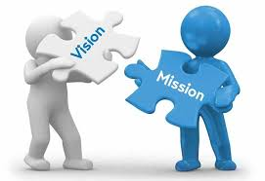
Chapter 3.1:
Clarification of the association's vision and mission
The association's vision statement:
  It is a declaration in which the association gives a description of the world as it envisages it in the sense of a better being of this world and its inhabitants (It can be very broad)
The association's mission:
  The association affirms what it considers to be its part in the realization of the previously announced vision (It can also be very broad but it concerns the contribution of the association)
The purpose of the association
  Over a more or less long period (5 or 10 years on average), corresponding to the duration of the Strategic Plan (SP), what change does the association aim to achieve through its actions in the field
  The objectives of the strategic plan
  The specific changes that the association plans to make in the period, to see an evolution towards the announced goal

Slide 5

Chapter 3.2:
Analysis of the general context of the association
Our environment at the scanner (Whiteboard exercise):
  On the whiteboard with a cloud in its center with the name of "your association" written on it, each of the participants is invited to write down the known situations or events that occur around them and which, although not dependent on them, influence their associative work
Debriefing to understand the meaning of the elements indicated by the participants
  How do these events influence our work?
Group work
  Discuss a chosen event on the list in your group and discuss the impact on your work and make recommendations to control or minimize these impacts.
  If time permits, do the same for a second event

Slide 6

Chapter 3.2:
Analysis of the general context of the association
Trainer's comment following group reports
  The development of our ability to observe new events and trends in our environment is very important for strategic planning
  Foresight consists of carrying out diagnoses, or developing scenarios (trends and alternatives) and issuing hypotheses and recommendations in terms of public policies or business strategy.
  Strategic planning is closely linked to foresight.
  Thus, the exercise we have just done together is the very first step of the SP and its exhaustiveness is recommended for the success of the process

Slide 7
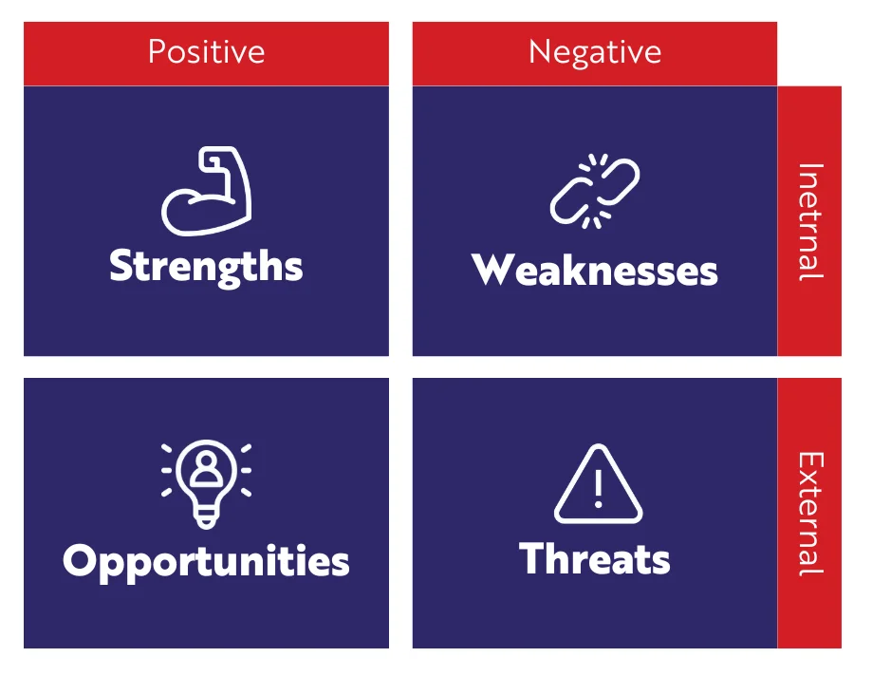
Chapter 3.3 :
SWOT-C analysis
The second step of the SP is to self-assess through a SWOT exercise:
  S : Strengths
  W : Weaknesses
  O : Opportunities
  T : Threats
  NB: A new school of thought is trying to change "threats" with "challenges"
Exercise to be done before the next session:
  Identify the strengths, weaknesses, opportunities and threats you see in the development of your association

Slide 8
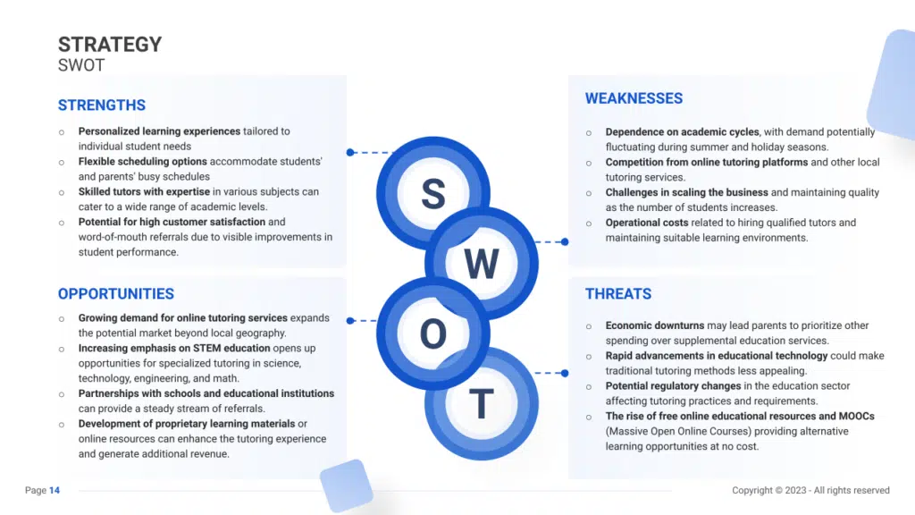
Chapter 3.3- Example of SWOT for an Online Training Program

Slide 9

Chapter 3.4:
Prioritization of strategic areas of development
Before prioritization, we need to identify the areas of development of our association. The first step is to propose the objectives aimed at:
  Capitalizing on and maintaining strengths
  Correct weaknesses and remove or minimize them
  Seizing the opportunities identified
  Anticipate identified threats or challenges
The result of this reflection should make it possible to formulate avenues or axes of development
Then, it will be necessary to retain the 2 or 3 priority axes by abolishing or merging some of them

Slide 10
Chapter 3.5:
Development of the logical framework of the SP
The logical framework that is the format for presenting the strategic plan (Detailed) will be developed when all components are ready. These are:
  Vision, mission, purpose,
  Strategic axes with associated objectives
  For each goal, the activities needed to achieve them
Then, it will be necessary to identify for each activity, the persons responsible for implementation, the period and/or deadline, the resources and the types of assistance needed

Slide 11

Chapter 3.6:
SP budgeting and mobilization of strategic partnerships
Budgeting the strategic plan is an extremely important step because it is what ensures its execution and success
It requires collaboration between
  the actors of programming and implementation (who alone can indicate the resources needed)
  and financiers who know how to estimate the availability of these resources
The last step in the process is the search for strategic partners (technical and financial)
When implementing, be prepared for ongoing evaluation and revision of the plan when necessary

Slide 12

CONCLUSION
Strategic planning is a major tool for ensuring the development of an organization in a context of ruthless competition, information warfare and economic intelligence
Associations are no exception to this reality of competition, and must fight to have a place under the sun
Today, strategic planning has made a great qualitative leap to join FORESIGHT to go beyond short-term plans and be part of the long term and in geopolitics and geoeconomics

