Slide 1
Organizational Development in the Context of an International Civil Society Organization (ICSO)
Training of Heads of FOASPS Member Organizations in Association Management and Organizational Development (OD)
Module 5 :
Approaches to Grant Research
(Webinar 5)

Slide 2

Module 5 : Session Objective
By the end of the session, participants will have acquired relevant knowledge to:
Base their grant research approaches on facts within the general context of the resource mobilization
Improve their grant application development through the design of quality project and program proposals
Integrate into their approach, the ethics of social activity specific to humanitarian associations

Slide 3
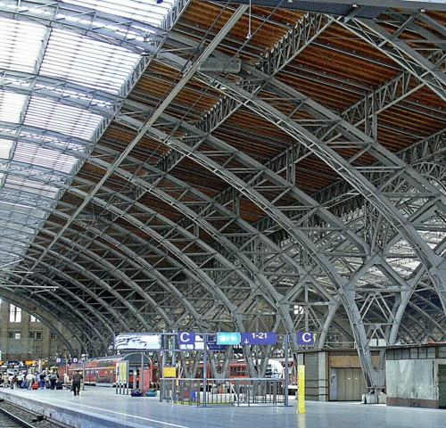
Session Structure and Outline
Chapter 5.1: Seeking Grants in the Overall Framework of Resource Mobilization
Chapter 5.2: Grant Application Development: Project Proposals and Programs
Chapter 5.3: The Ethics of the Social Activity of the Humanitarian Association

Slide 4

Chapter 5.1 (1/4):
Seeking grants as part of the overall framework of resource mobilization
Reminder: The different sources of funding for an association
Self-financing :
Donations and legacies:
Public aid:
Sponsorships and patronage:
Bank financing:
Profit-making activities:
Crowdfunding
Internal funding represents the first financial resources of a not-for-profit association
Carried out without compensation, they definitively become part of the association's heritage
In kind or in cash, subsidies are used to finance projects of general interest.
Also called sponsorship, it allows you to finance an association, in exchange for a counterpart or ad services
An association can take out a traditional bank loan or a furniture leasing to finance itself
A not-for-profit association can carry out economic activities to finance its activities incidentally
Crowdfunding makes it possible to raise funds via specialized digital platforms

Slide 5

Chapter 5.1 (2/4):
Seeking grants as part of the overall framework of resource mobilization
Potentials and challenges in relation to each source of funding
SOURCES | OPPORTUNITIES | CHALLENGES
Self-financing :
Donations and legacies:
Public aid: (National and TFP)
Sponsorships and patronage:
Bank financing:
Profit-making activities:
Crowdfunding

Slide 6

Chapter 5.1 (3/4):
Seeking grants as part of the overall framework of resource mobilization
Potentials and Challenges for Each Funding Source: The Case of FOASPS
SOURCES | OPPORTUNITIES | CHALLENGES
Self-financing :
Donations and legacies:
Sponsorships and patronage:
Sponsorships and patronage:
Bank financing:
Profit-making activities:
Crowdfunding
Our members are associations like us
The nobility of the mission pleads for us
It is the most reliable and sustainable source if...
The nobility of the mission pleads for us
Absence of solidarity or social banks
The scope of activities is vast (expert services)
High potential compared to cases observed elsewhere
They themselves have challenges for collection
Donors have not yet been identified
The lack of vision of public actors
Patrons seem difficult to identify
Identify profitable and bankable activities
Distinguishing between gainful activities and others
Develop appropriate digital solutions

Slide 7
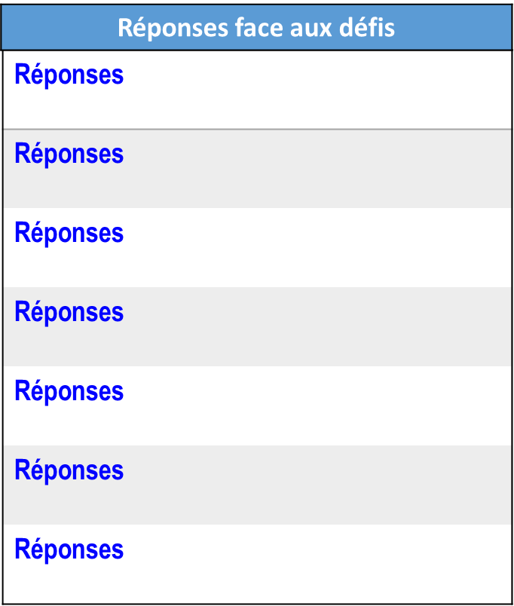
Chapter 5.1 (3/4):
Seeking grants as part of the overall framework of resource mobilization
Potentials and Challenges for Each Funding Source: The Case of FOASPS
SOURCES | OPPORTUNITIES | CHALLENGES
Self-financing :
Donations and legacies:
Sponsorships and patronage:
Sponsorships and patronage:
Bank financing:
Profit-making activities:
Crowdfunding
Our members are associations like us
The nobility of the mission pleads for us
It is the most reliable and sustainable source if...
The nobility of the mission pleads for us
Absence of solidarity or social banks
The scope of activities is vast (expert services)
High potential compared to cases observed elsewhere
They themselves have challenges for collection
Donors have not yet been identified
The lack of vision of public actors
Patrons seem difficult to identify
Identify profitable and bankable activities
Distinguishing between gainful activities and others
Develop appropriate digital solutions

Slide 8
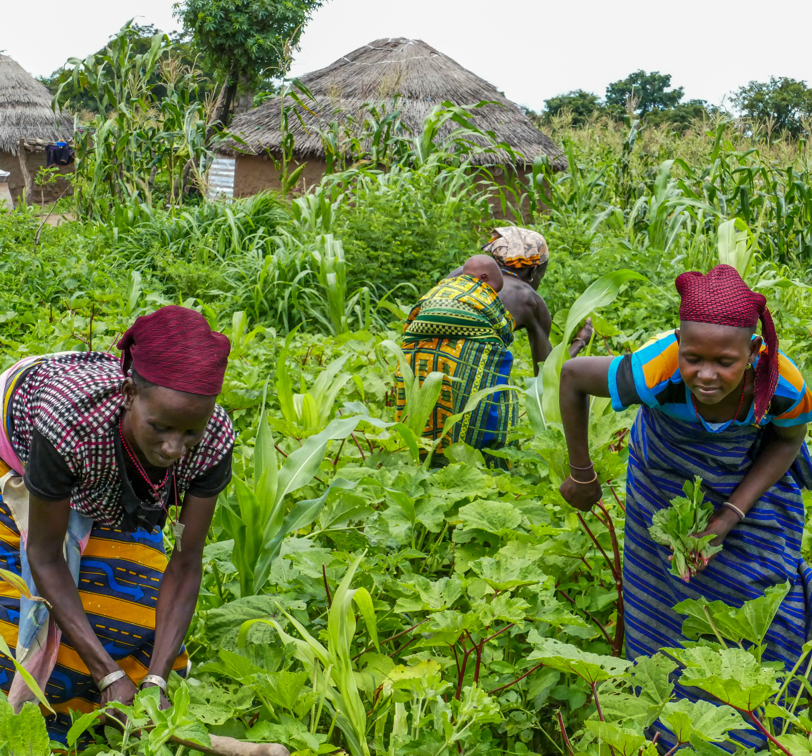
Chapter 5.2 (1/6):
Grant Application Development: Project and Programs Proposals
  Knowing the Proposal Requester/ Grant Application Recipient
  Understanding the grant application process
  Reading and analyzing grant guidelines
  Following instructions and meeting deadlines
  Incorporating a presentation of your organization and its past achievements
  Writing a compelling statement of needs

Slide 9
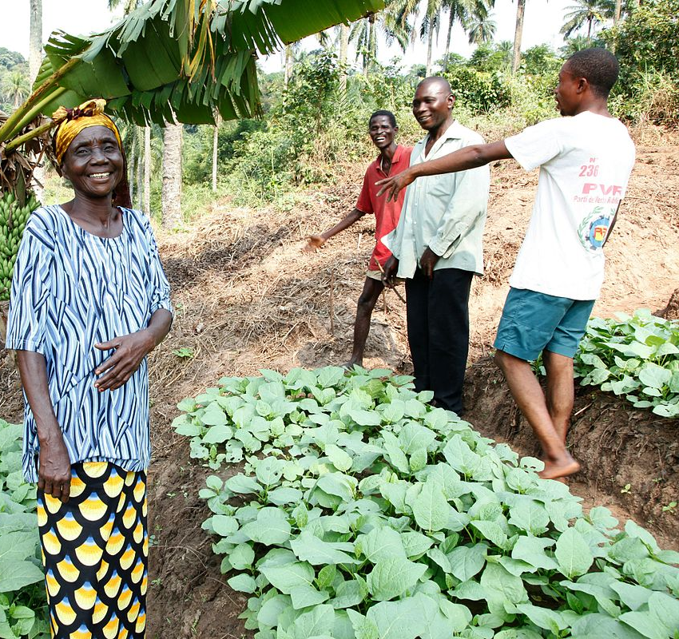
Chapter 5.2 (2/6):
Grant Application Development: Project and Programs Proposals
Support your claims with reliable data and evidence
  Set clear goals and results
  Develop a realistic budget
  Demonstrate the impact and benefit for the community
  Networking at conferences and events
  Common mistakes to avoid
  Poor understanding of the funder's goals and priorities
  Forgetting the required documentation
  Use of inconsistent or inaccurate language
  Lack of clear and convincing evidence

Slide 10

Chapter 5.2 (3/6):
Preparation of grant applications
Resources and tools for writing grant applications
Grants.gov : (https://www.grants.gov/) : A comprehensive source for finding federal grants in the United States.
GlobalGiving.org : (https://www.globalgiving.org/) : Connects nonprofits, donors, and businesses in almost any country to support a variety of projects.
Le Centre de la Fondation (Candid) : (https://candid.org/) : Candid provides a wealth of information on foundations and their grants, including a global database.
Idéaliste : (https://www.idealist.org/) : Idealist is a platform that connects individuals with opportunities, including grants and funding for projects around the world.
Guide des financements européens : (https://www.european-funding-guide.eu/) Focuses on funding opportunities in Europe for students, researchers and organisations.

Slide 11

Chapter 5.2 (4/6):
Preparation of grant applications
Resources and tools for writing grant applications
Fonds pour les ONG : (https://www2.fundsforngos.org/) : A platform providing information on grants and resources for NGOs globally.
Devex : (https://www.devex.com/) : Devex is a media platform for the global development community and also offers a database of jobs and funding.
Espace subvention : (https://grantspace.org/) : A service of Candid, Grant Space provides resources and information to support the social sector.
Open Society Foundations : (https://www.opensocietyfoundations.org/) : The Open Society Foundations provide grants to projects and initiatives around the world, focusing on justice, governance and human rights.
AidData : (https://www.aiddata.org/) : AidData focuses on tracking and visualizing international development funding, including grants from various organizations.

Slide 12
Chapter 5.2 (5/6):
Preparation of grant applications
Sources of health sector funding
According to your present knowledge of donors’ policies, can you select those with a good grounding (With opportunities offers) on the health sector?
What other sectors or areas of intervention are also manageable for country federations in terms of funds hunting?
Before talking about writing proposals , responding to these questions here above is important as it can help you to factor your alerts criteria to fine tune your selection for calls for proposals

Slide 13
Chapter 5.2 (6/6):
Preparation of grant applications
Healthcare focus donors
Grants.gov : (https://www.grants.gov/) : A comprehensive source for finding federal grants in the United States.
Fonds pour les ONG : (https://www2.fundsforngos.org/) : A platform providing information on grants and resources for NGOs globally.
Devex : (https://www.devex.com/) : Devex is a media platform for the global development community and also offers a database of jobs and funding.
Amplify Change : (https://amplifychange.org/apply/) offers grant, ranging from our smallest opportunity grants, (supporting civil society organizations, working at a local level), to largest partnership grants, (supporting established groups to strengthen civil society movements)

Slide 14

Chapter 5.3 (1/2):
The ethics of the social activity in a humanitarian association
How the question arises
  Are we humanitarian associations?
  Can the health sector be non-humanitarian?
  A reminder of the different aspects of humanitarian aid
    State humanitarian aid
    Philanthropic humanitarian aid
    Religious humanitarianism
    Humanitarian health
    Humanitarian aid in crisis and emergency management
  The concepts and language of humanitarian aid
    The private lives of the actors
    Inclusion (gender, disability, sexual orientation, race, nation, etc.)
    The duty to intervene against the sovereignty of states
    The Law of Noise (Advocacy and Denunciation)
    Access to victims in humanitarian crises
    Money in humanitarian aid (Where does it come from?)

Slide 15

Chapter 5.3 (2/2):
The ethics of the social activity in a humanitarian association
Money in humanitarian aid
  The origin of the money: it is necessary to ensure the diversification of sources
  The use of money received from partners must be the subject of all attention
  Transparency of budgets and their control by independent bodies is a major requirement
  Investment choices must be scrupulously scrutinized
  Having a charter of ethics that incorporates key values, including attitudes towards money and its use, can be helpful
  Be careful about ostentatious behaviors

Slide 16

CONCLUSION
  To be viable, an association must have a clear vision of the means it gives itself to achieve its objectives
  It must put the mobilization of its internal resources at the heart of the financing strategy for its activities
  It must diversify its sources of financing to create the conditions for its sustainability
  It must have a bank of projects with proposals to be adapted according to the opportunities it encounters
  It must promote ethics and good governance in the management of its finances
  It must strike a balance between its intrinsic nature, its social vocation and its humanitarian relevance

