Slide 1
Organizational Development in the Context of an International Civil Society Organization (ICSO)
Training of Heads of FOASPS Member Organizations in Association Management and Organizational Development (OD)
Module 6 :
Project Management
(Webinar 6)

Slide 2

Module 6 : Session Objective
By the end of the session, participants will have:
Put project management at the heart of the development of their association
Acquired the simple tools to develop projects that are relevant to their association's vision, mission and approach to intervention
Explored the mysteries of filmmaking, from a project start to closing

Slide 3

Session Structure and Outline
Chapter 6.1 - Interest of projects in the development of the association
Chapter 6.2 - Project Development: Model and Formats
Chapter 6.3 - Project Implementation, Reporting and Closing

Slide 4

Chapter 6.1:
Interest of projects in the development of the association (1/2)
  In the constitution of our associations, we have an article that defines the means to put in place to achieve our objectives. Some examples of means of action are:
    Conferences and seminars;
    Exhibitions and expos ;
    Research and publications;
    Study trips;
    Recreational activities;
    Income-generating activities (IGAs).
  Most of these means of action are projects to be designed, planned and implemented
  In addition, projects are a way to mobilize members to give meaning and value to their membership

Slide 5

Chapter 6.1:
Interest of projects in the development of the association (2/2)
  Projects are/must be included in the association's periodic action plans
  Even General Assemblies (or any other meetings) should be considered as projects in the same way as IGAs
  Each project is/must be entrusted to a project committee on the basis of Terms of Reference (ToR) for the commission (Although, often these ToR are verbal)
  The draft itself must be written in an adequate format to ensure a harmonized understanding by all stakeholders
  Every project must be supported by a budget and end with an activity report and a financial statement

Slide 6

Chapter 6.2 :
Project development: Model and formats (1/4)
  The preparation of a project may have been carried out by the Bureau, the administrative secretariat or entrusted to the project commission
  The choice of presentation model varies according to the situation and the destination. You can choose between:
    The Concept Note template;
    The Terms of Reference (ToR) model;
    The Framing Note template;
    The model of the Letter of Mission;
    The Business Plan template;
    The Business Case model.
  Let's take a few examples:

Slide 7

Chapter 6.2 :
Project development: Model and formats (2/4)
  Let's take a few examples: Tell us which models are best suited for the following projects:
    Organization of a medical innovation fair
    High-Level Conference on Health Policy
    Installation of an incinerator
    Creation of a medical laundry
    Creation of a Federation Newsletter
    Advocacy on free access to health care
    Blood donation operation by private health sector actors
    Organization of a walk against obesity
    Organization of the virtual FOASPS General Assembly
    Organization of an end-of-year dinner for members
  Give us the reasons for your choices.

Slide 8

Chapter 6.2 :
Project development: Model and formats (3/4)
  The following projects may be limited to a mission letter, a framework note, a concept note, or a Terms of Reference (ToR);
    Blood donation operation by private health sector actors
    Creation of a Federation Newsletter
    Organization of a walk against obesity
    Advocacy on free access to health care
    Organization of an end-of-year dinner for members
  Because these can be projects whose objective is not to generate financial resources for the association, but actions whose implementation contributes to the objective and mission of the association
  On the other hand, these projects may include a search for sponsorship or subsidies to be included in the budget

Slide 9
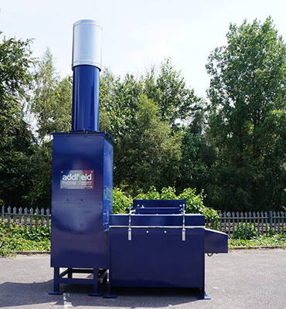
Chapter 6.2 :
Project development: Model and formats (4/4)
  The following projects require a business case or a business plan:
    Organization of a medical innovation fair
    High-Level Conference on Health Policy
    Installation of an incinerator
    Creation of a medical laundry
    Organization of the virtual FOASPS General Assembly
  These are large-scale projects, which require the association to ensure their success, not only for its image, but also for its finances.
  It is therefore important to have a market study/ business case, to ensure that there is an economic and financial profitability
  The budget must ensure a minimum balance between revenue (including subsidies) and expenditure

Slide 10

Chapter 6.2 :
Project development:
Some sample Formats: Concept Note (1/2)
Project Title
Short description of the project
Disadvantaged group targeted by the project
Location or Development Site of the Project
Poverty issues targeted by the project
Project/Program Duration: Likely start of the project
Actors involved in implementation
Project components
Context
Problematic
Situation analysis: current solutions and limitations
Past experiences of the Promoting Association
New or innovative approaches to the project
Changes or expected results of this project
Measures to sustain the gain/ impact
Main project activities
Schedule of project phases
Project Performance Measurement Systems
Necessary technical skills, competencies and abilities
Estimated budget
Contribution from the various actors

Slide 11
Chapter 6.2 :
Project development:
Some Model Formats: Concept Note (2/2)
TEN QUESTIONS TO BE ANSWERED IN THE PROJECT DESCRIPTION
What is the poverty problem that the project will address? What are the root causes of this problem?
What are the project objectives?
Who are the target groups and how will they benefit from this project? How will this project contribute to reducing poverty/improving opportunities for target groups to help them become a real development actor? (For research projects, how this research will promote a better knowledge of the target group?
How will the target groups themselves participate in the conceptualization of the project?
Will the project contribute to addressing the root causes of the problems and concerns described above? How?
What are the innovations in the project? How does the project contrast with current approaches to solving problems?
What are the significant expected results after three years of project implementation? What major activities will be undertaken? Specify the levels of participation of the target groups in the implementation of each activity.
How will the project facilitate the development of partnerships, especially between the target groups and other institutions?
How will the project be continued in a sustainable way after the funding period? Will the project or individual project components be taken over by the target groups after the project period? What are these components and how will the target groups be prepared to take over?
How can the project be scaled up after the funding term and/or duplicated in regions or areas with similar conditions?

Slide 12
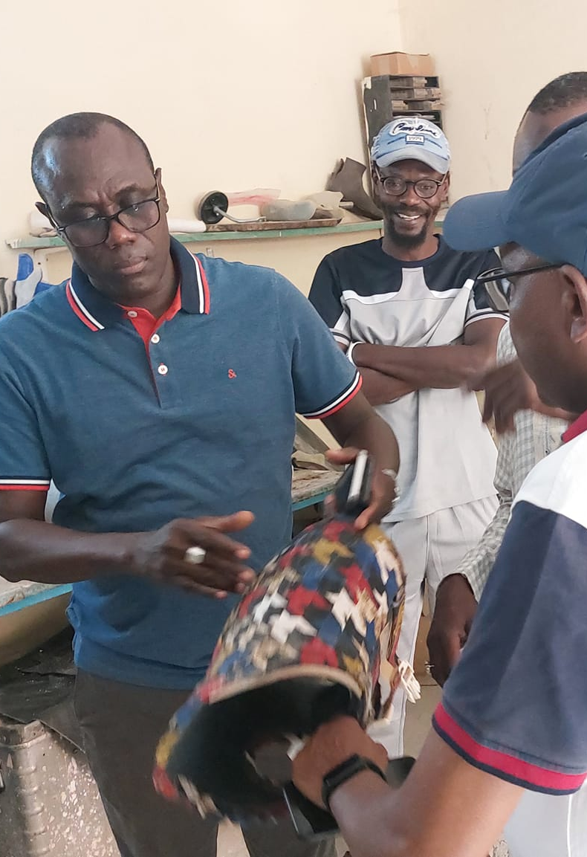
Chapter 6.2 :
Project development:
Some sample Format: Terms of Reference
  Introduction
  Background and rationale
  Objectives (general, specific)
  Project Description (Components, Key Activities)
  Theory of Change
  Tasks/ Mandate/ Missions of the various actors
  Expected results
  Implementation Methodology or Approach
  Expected outputs
  Logical framework
  Monitoring and evaluation framework: Indicators
  Timeline
  Anticipated budget and funding sources
  Conclusion and call for TFPs

Slide 13

Chapter 6.2:
Project development:
Some Template Formats: Framing Note
Case of a mission to write a manual-guide and a training course in biomedical interviewing
Context of the intervention:
Mandate of the consultant trainer
Execution of the mission
Organization of the mission
Methodological pedagogical approach
Reporting requirements
Working language
Proposed dates
Qualifications of the Consultant Trainer
Mission timeline

Slide 14

Chapter 6.2 :
Project development:
Some Model Formats: Engagement Letter
  The engagement letter is in fact a compressed formula of the terms of reference and the contract
  It is a suitable formula for entrusting small projects to a consultant or a project team
  However, it must contain (non-exhaustively)
    The references of the person (individual or institution) who places the order
    Definition of the recipient of the engagement letter
    The description of the project and its main articulations
    What is expected of the recipient, with the dates and the material and human resources made available to him/her
    The source of the budget and the framework for budget implementation
    The method and mechanisms of reporting
  The client must sign the engagement letter.
  The recipient or their representative can sign it as well

Slide 15

Chapter 6.2 :
Project development:
Some Template Formats: Business Plan (1/7)
  The business plan is a more comprehensive project document that falls under the jurisdiction of experts. But it still needs to be validated by the members of the Association. It is structured as follows:
  Material Safety Data Sheet
  The Business Plan
  Strategy
  Finance
  Presentation of the sponsoring organization
  Needs and gaps to be filled
  Annexes

Slide 16

Chapter 6.2 :
Project development:
Some Template Formats: Business Plan (2/7)
  Material Safety Data Sheet (1 or 2 pages)
  Project identity sheet (any information allowing you to have an idea of the project on one page)
  Contact person (the respondent for more information)
  Executive summary of the project (1/2 or 1 page)
    Instructions for the Executive Summary:
    Base yourself on the structure of a pitch:
    Introductory hook
    Opportunities or problems of target audiences
    Existing and competing solutions on the market
    Your offer of solution
    Its advantages
    Your needs

Slide 17

Chapter 6.2 :
Project development:
Some Template Formats: Business Plan (3/7)
  The Business Plan
    Context
    Opportunity and target audiences
    Market and segmentation
    Key success factors
    Competition
    Service offer
    Means of production
    Distribution
    Marketing, communication, promotion and sales
  Strategy
    State of play
    Trends
    SWOT analysis
    Risk analysis
    Vision of the future and strategy
    Action plans and projects

Slide 18

Chapter 6.2 :
Project development:
Some Template Formats: Business Plan (4/7)
  Finance
    Assumptions and scenarios used (Consistent with income streams, financial projections)
    Key figures: The financial plan must take into account:
      The evolution of sales;
      The evolution of revenues;
      The evolution of direct charges;
      The evolution of fixed costs;
      Investments;
      The necessary financial contributions, their repayment and the payment of interest;
      Cash.

Slide 19
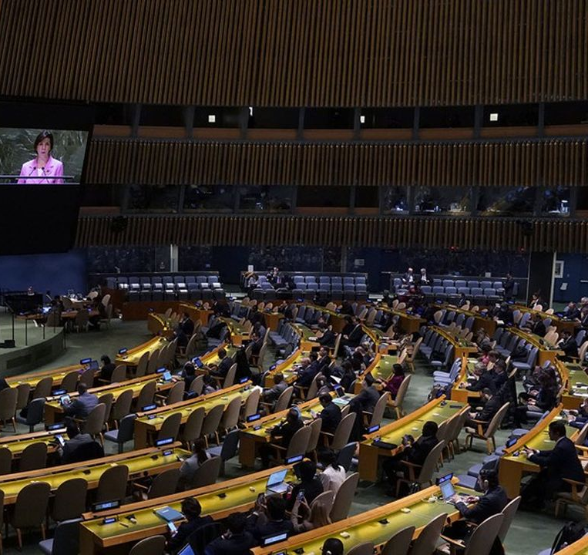
Chapter 6.2 :
Project development:
Some Template Formats: Business Plan (5/7)
  Presentation of the promoting organization, through its human resources (Teams and skills):
    Its founders and partners, their motivations
    Its values and passions;
    Its management team,
    The key skills of the organization's employees;
    External resources used to fill any gaps (legal, accounting, etc.);
    Management method, remuneration policies and management structure

Slide 20

Chapter 6.2 :
Project development:
Some Template Formats: Business Plan (6/7)
  Needs and gaps to be filled
    Materials
    Infrastructure
    Equipment
    Workforce / skills
    External services / benefits
    Finance
  How to proceed?
    Present your needs to allow your organization to move through your project, towards its vision of the future.
    Be clear and precise about your requests and contributions
    Indicate how you plan to meet your other needs.

Slide 21

Chapter 6.2 :
Project development:
Some Template Formats: Business Plan (7/7)
  Appendices: Use this part to complete the information (as needed for understanding)
    financial plans,
    the schedules of the project phases,
    timelines,
    resumes,
    patents,
    Meaningful photos
    Etc.

Slide 22

Chapter 6.2 :
Project development:
Some Model Formats: Feasibility Study (1/2)
  A feasibility study is the result of the same analysis that results in a business plan
  What it adds is to provide information on the chances of success or failure of the project
  It is interested in several factors, namely:
    Economic and financial factors
    Technological factors
    Operational and organizational factors
    Legal Factors
    Business Factors
  NB: A project may be economically viable and not financially viable

Slide 23

Chapter 6.2 :
Project development:
Some Model Formats: Feasibility Study (2/2)
  It proceeds from the following steps:
    Step 1: Identify specific objectives
    Step 2: Study the project environment
    Step 3: Determine the needs and budget
    Step 4: Calculate the ROI of the project
    Step 5: Create multiple scenarios
    Step 6: Choose the ideal scenario and move on to the next steps
  It must be at the very beginning of the project, and inform the decision to continue or not

Slide 24

Chapter 6.3 :
Project implementation, reporting and closing (1/4)
  Group work: (Three virtual rooms)
  Group 1: Elements to be monitored during the implementation
    What are the potential risks or challenges?
    What do you think are the elements to look at during the implementation of the project?
  Group 2: How to report on implementation monitoring
    When to produce reports during the course of the project?
    Who are the reports recipients?
    What should be the content of the reports?
  Group 3: How to close a project?
    What determines the end of a project?
    What does it take to close a project?
    What happens to the leftovers of the resources mobilized?

Slide 25

Chapter 6.3 :
Project implementation, reporting and closing (2/4)
  What to watch out for during the project
  What are the potential risks or challenges?
    Change in the overall context from the situation at the time of design (Political crises, natural and/or human disasters
    Loss of key project skills (turnover)
    Broken subsidy promises
    Lack of member engagement
  What should I look out for during the project?
    The adequacy of existing human resources with needs
    Availability of funds as planned
    The need to readjust ambitions, or reframe planned activities
    Search for additional or new resources
    The means of motivation of the association's members to fill the gaps

Slide 26

Chapter 6.3 :
Project implementation, reporting and closing (3/4)
  How to report implementation monitoring
  When to produce reports during the course of the project?
    Periodic reports (monthly or quarterly)
    Mid-term and end-of-project report
    Detailed reports (To inform a public relations operation)
  Who are the reports recipients?
    Reports to Members and Executive Council
    Donor Reports
    Knowledge Management Report
  What should be the content of the reports?
    Distinguish between activity reports, monitoring and evaluation reports and financial reports
    Plan reports in the form of stories to be told to produce success stories
    Do not forget the significant photos of the material achievements

Slide 27

Chapter 6.3 :
Project implementation, reporting and closing (4/4)
  How do I close a project?
  What determines the end of a project?
    The expected completion date of the project
    The end of funding
    Achievement of announced objectives and expected results
    The recipients' observation/desire to end the collaboration
  What does it take to close a project?
    Make the end-of-project report public, including the financial report
    Sharing lessons learned and recommendations with different stakeholders
  What happens to the leftovers of the resources mobilized?
    All the resources of the project (human, material and financial) must be returned to the association, the donors or made available to the actors identified in advance in the financing agreement

Slide 28
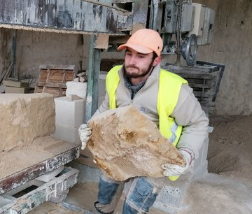
CONCLUSION
  The design, implementation and completion of a project is always an exciting adventure
  Every project in your Organization is a building block in the process of a beautiful construction
  Always remember that having reached project closeness, no matter how big or small, it is an achievement that should be celebrated… and credit should be given to the project team

