Slide 1
Organizational Development in the Context of an International Civil Society Organization (ICSO)
Training of Heads of FOASPS Member Organizations in Association Management and Organizational Development (OD)
Module 7 :
Implementation and performance management
(Webinar 7)

Slide 2

Module 7 : Session Objective
By the end of the session, participants will have an in-depth knowledge of:
The development of a performance management policy
Organizational performance management?
Organizational and personnel performance management tools

Slide 3
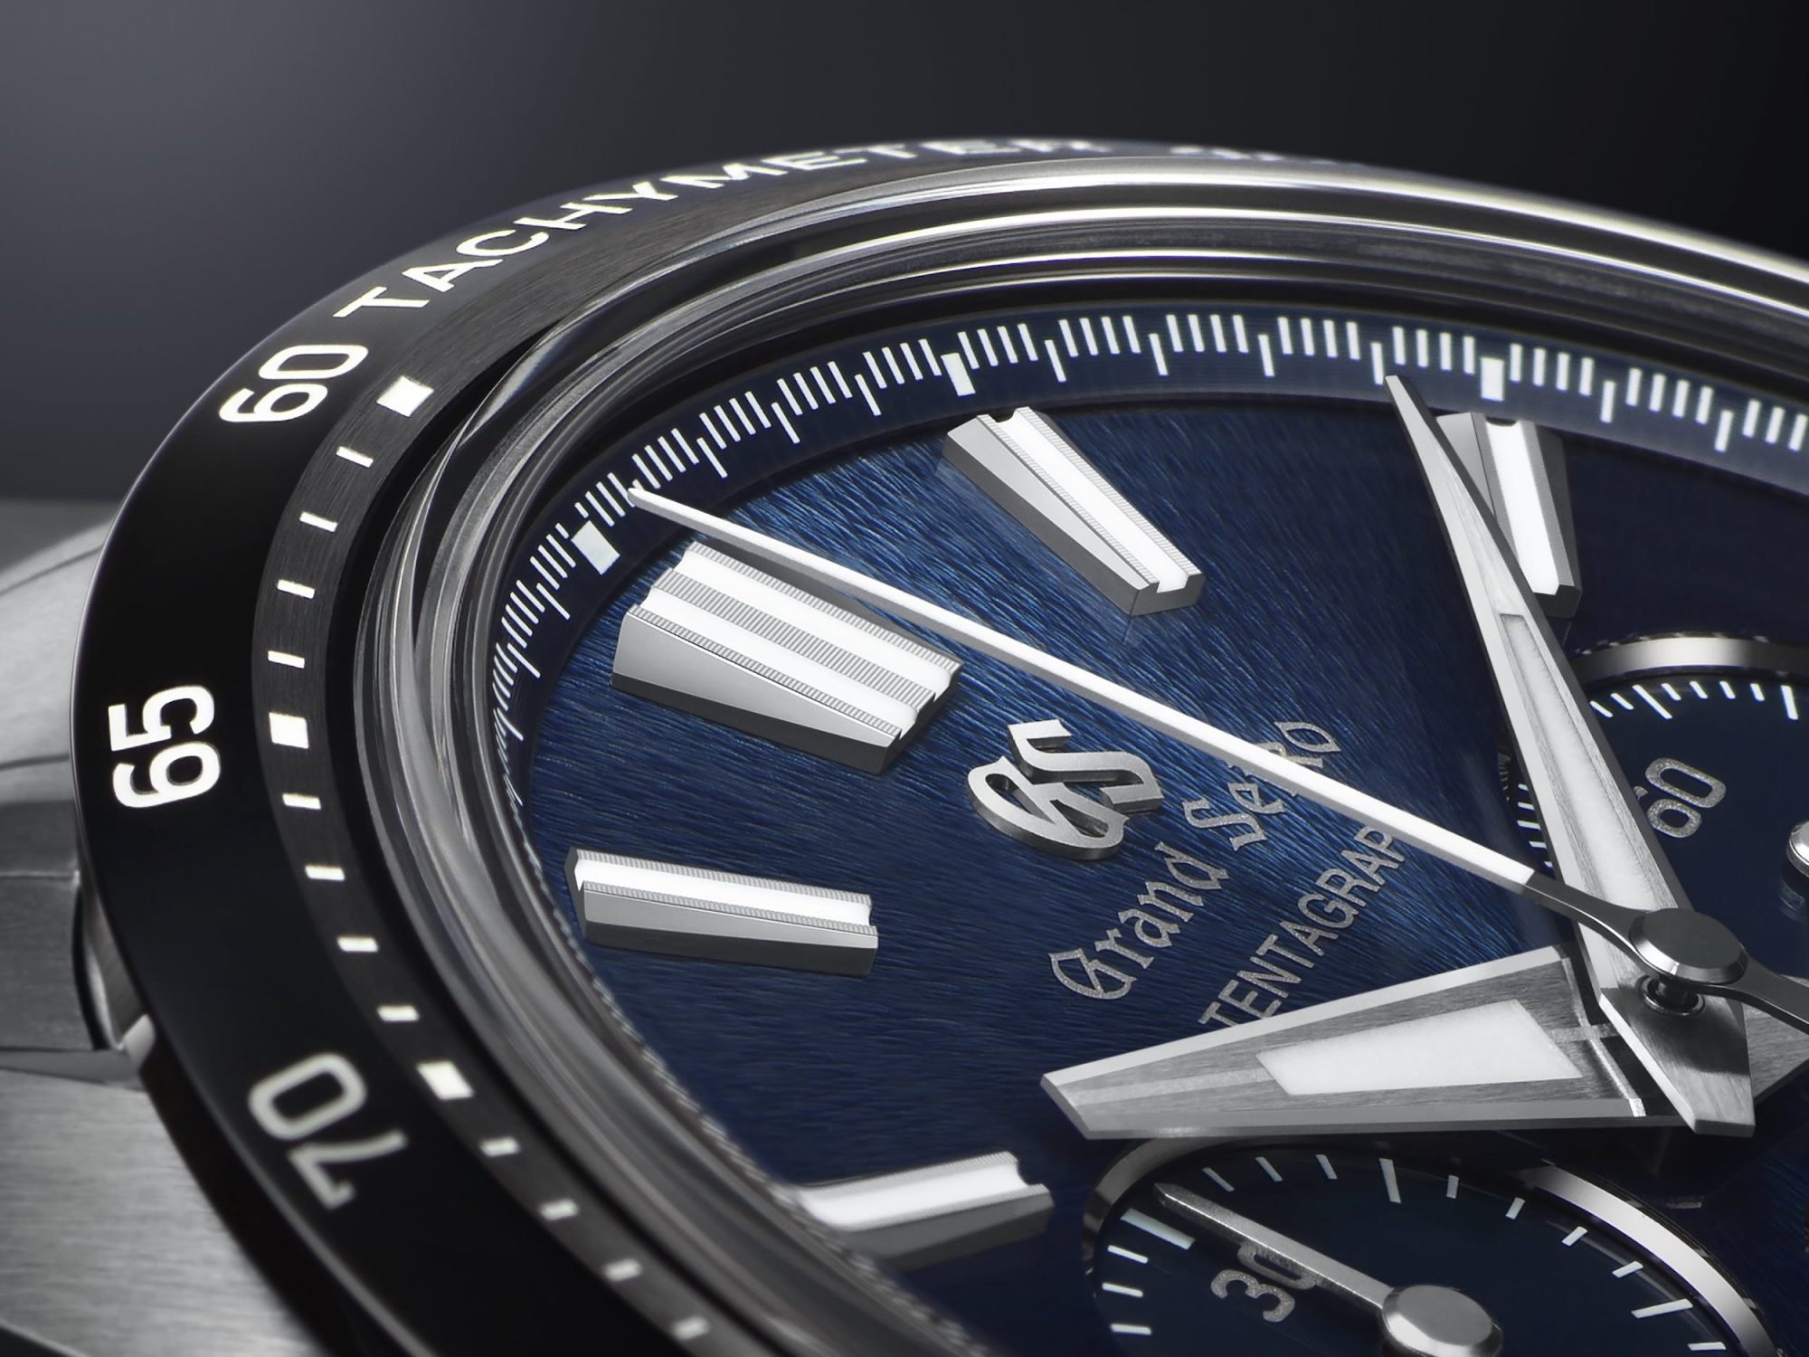
Session Structure and Outline
Chapter 7.1: Development of a performance management policy
Chapter 7.2: What is Organizational Performance Management?
Chapter 7.3: Organizational and People Performance Management Tools

Slide 4
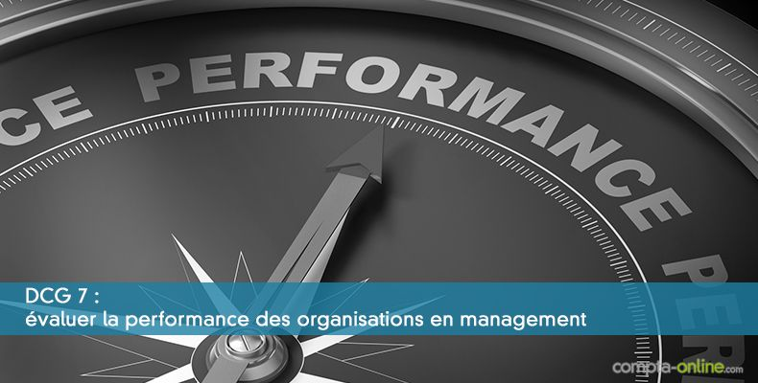
Chapter 7.1 : Development of a management policy
of overall performance – GPG (1/2)
  Global Performance Management is a lever for the growth of the Organization
  It is an essential part of the organizational culture
  It establishes and maintains a clear link between individual and organizational performance, in order to:
    Boost organizational culture and employee engagement
    Increase productivity and overall efficiency
    Contribute to the achievement of the Organization's objectives
    Create a positive impact on customer satisfaction

Slide 5

Chapter 7.1 : Development of a management policy
of overall performance – GPG (2/2)
  How to Increase Overall Productivity with Performance Management
    Set clear expectations
    Align individual and team goals with overall goals
    Use performance indicators and data analysis
    Optimize feedback
    Foster employee engagement
    Promote a performance-based rewards system

Slide 6
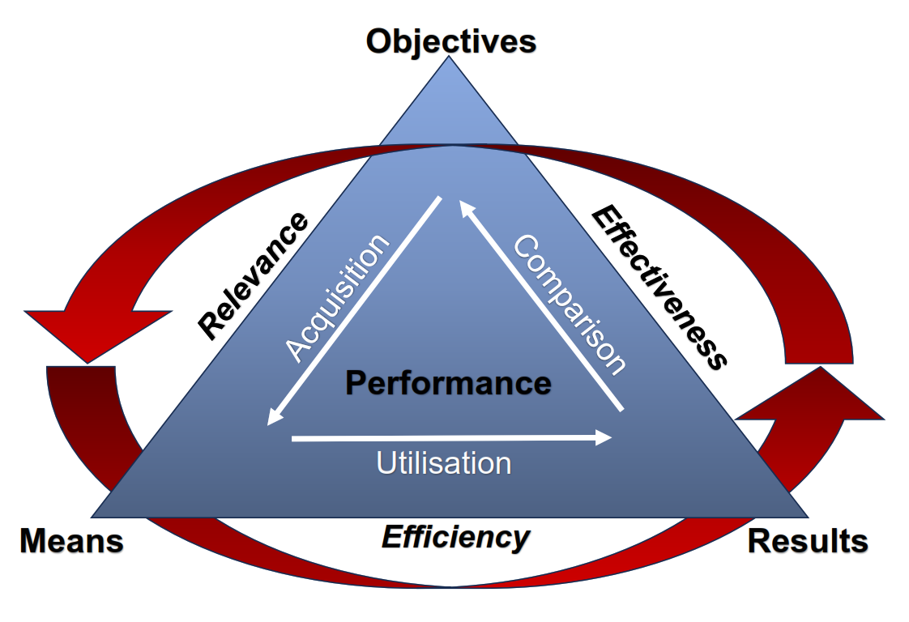
Chapter 7.2 : What is organizational performance? (1/3)
  Organizational performance management (OPM) is defined as how an organization plans, organizes, controls, and directs itself to achieve its goals, implement a strategy, or accomplish a job or activity.
  It revolves around three key points of attention that govern managerial choices:
    Relevance
    Efficiency
    Effectiveness

Slide 7
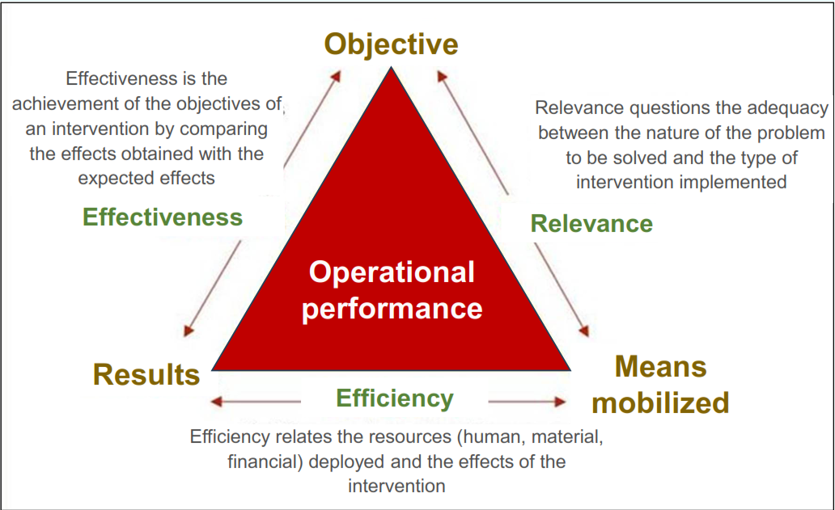
Chapter 7.2 : What is organizational performance? (2/3)
  Hervé Benvoglio
  A Consultant in Management, Continuous Improvement and Project Management, offers this Pyramid of Organizational Performance to explain performance management

Slide 8

Chapter 7.2 : What is Organizational Performance? (3/3)
  For the organization, it is a question of asking itself the precise questions before any choice of implementation of projects and programs:
  Relevance: Is the type of intervention chosen, the most likely to help us solve the identified problem?
  Effectiveness: Will the solutions be optimal for the chosen option (e.g., direct intervention or implementing partners)
  Efficiency: Will we have the best value for money – Cost (Relative to the resources committed?

Slide 9

Chapter 7.2 :
How does Global Performance Management (GPM) relate to People Performance Management (PPM)?
  Global Performance Management (GPM) is structured around OPM and PPM
  Why is PPM important? It allows:
    Better alignment of objectives between staff (Individuals) and the Organization
    Increased employee engagement and productivity by giving them a sense of purpose that boosts their engagement
    Better managerial leadership since it sharpens both your management skills and the skills of your employees
    Improved organizational performance leading to greater growth in resources and improved customer/beneficiary satisfaction

Slide 10
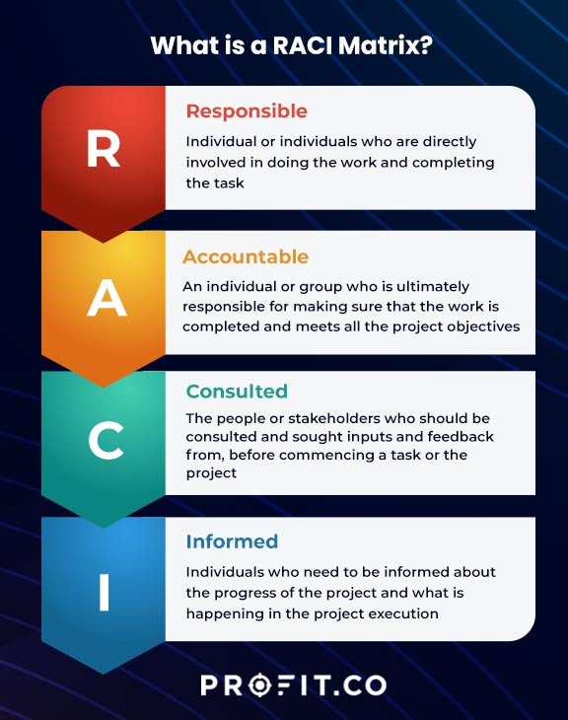
Chapter 7.3 :
Performance Management Tools and personnel (1/4)
  Manual/ physical tools
  The M&E framework with key performance indicators (KPIs)
  Performance evaluation model based on:
    Periodic reporting
    Planning and monitoring of results
    Periodic discussion between supervisor and supervisee
  The 360° evaluation system
  The RACI model

Slide 11
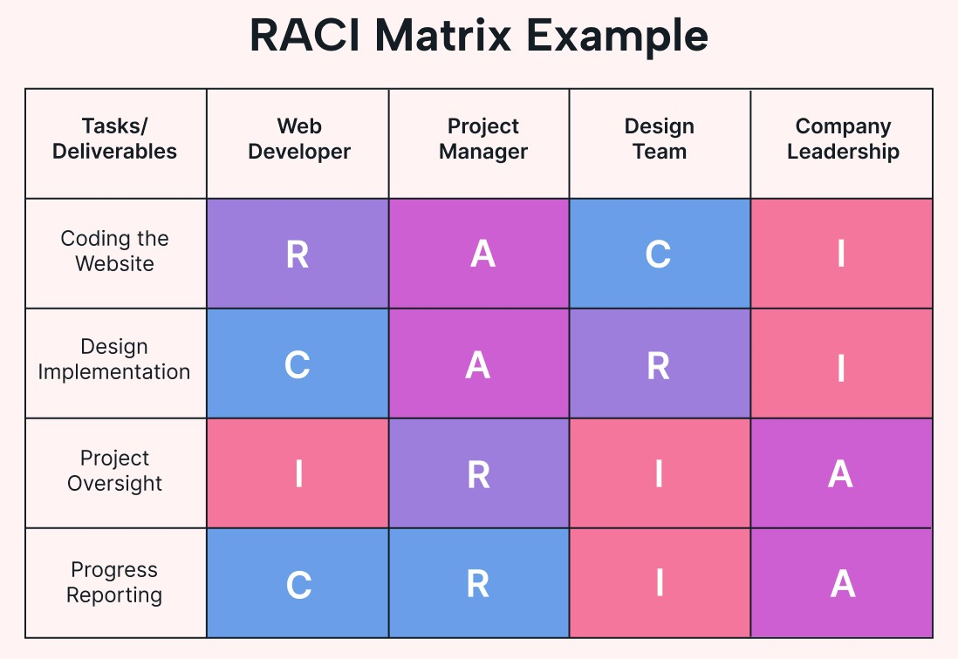
Chapter 7.3 :
Performance Management Tools and personnel (2/4)
  The RACI Model
  R : Responsible
  A : Accountable
  C : Consulted
  I : Informed

Slide 12

Chapter 7.3 :
Performance Management Tools and personnel (3/4)
  Electronic Tools (Apps)
  Performance management software (Poplee entretiens, Trakstar)
  Performance management and professional development software (Angagedly)
  Annual Review Management & Evaluation Software (Javelo)
  Performance management and feedback platform (Leapsome, WorkTango)
  360-degree feedback platforms (Treillis, Primalogik)
  Talent and performance management software (ClearCompany)
  Employee Performance Management, Motivation, and Engagement Software (15Cinq/ 15Five, Motivation)

Slide 13

Chapter 7.3 :
Performance Management Tools and personnel (4/4)
  How to choose a performance management tool
  Size of the organization
  Specific needs for your organization
  The context of your sector of activity
  Specific features sought
  Budget Considerations
  Integration and compatibility
  Performance methodology
  360° and anonymous feedback
  Continuous and real-time availability of information
  Purpose and use of the performance management tool

Slide 14
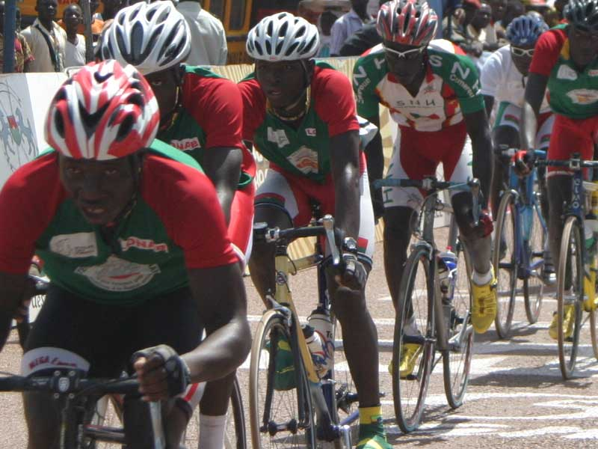
CONCLUSION
  And to conclude:
  How to get your team to PERFORM?
  (By Ken Blanchard, CEO of Blanchard Training & Development)
    Purpose
    Empowerment of team members
    Relations & communication
    Flexibility (AGILE Organization)
    Optimal productivity
    Recognition & Reward
    Morale of Team members

